Slide 1




WASTE MANAGEMENT SYSTEM
TEAM-2
DHARSHIKA S | NARAYANAN S | PRANAY TEJA

Slide 2


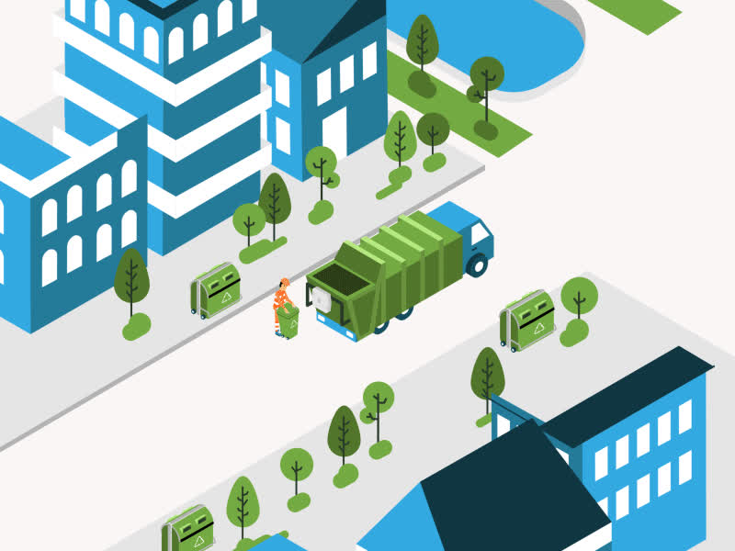
AGENDA
Introduction
Problem Statement
Solution
Project Overview
Output
Conclusion

Slide 3

INTRODUCTION
Waste management is essential for maintaining cleanliness and sustainability, especially with the growing population and waste generation. Manual waste collection often leads to inefficiencies like mismanagement and delays. This project proposes an online Waste Management System that allows users to schedule waste collection, track the status of their requests, and receive notifications, ensuring a more organized and efficient waste disposal process.

Slide 4
PROBLEM STATEMENT
Managing waste collection manually can result in inefficient service, uncollected waste, and delayed responses to user requests. Users may face issues tracking the status of their waste collection requests, leading to dissatisfaction and environmental hazards. Additionally, waste collection services often struggle to organize schedules effectively and communicate updates to the public in real time.

Slide 5
Project OverView
USER FEATURES
SIGN UP
Create a new user account to access the application.
LOGIN
Access your account using your username and password.
CREATE REQUEST
Submit a new waste collection request by providing necessary details.
REQUEST STATUS
Track the status of your waste collection request in real time.
CANCEL REQUEST
Withdraw a previously submitted request if necessary

Slide 6
Project OverView
ADMIN FEATURES
LOGIN
Access the administrative dashboard with your credentials.
VIEW REQUESTS
Review all incoming waste collection requests from users.
APPROVE/REJECT REQUESTS
Manage requests by approving or rejecting them based on availability and resource

Slide 7
Project OverView
User Features (Notifications Module)
NOTIFICATION UPDATES
Receive email alerts about the status of your waste collection request (e.g., request approval, schedule updates).
REMINDERS
Get timely reminders for upcoming scheduled pickups or actions required on your request.

Slide 8

SOLUTION
This project proposes a Waste Management System that automates the waste collection process.
Users can register on the platform, request waste collection services, schedule the collection, and track the status of their requests in real-time.
The system sends notifications to users to keep them informed about the progress.
The platform also provides an administrative dashboard where admins can manage requests, assign tasks, and monitor the collection process efficiently.
This approach streamlines waste management operations, ensuring timely service and better communication with users

Slide 9
CONCLUSION
The Waste Management System offers a practical solution for automating waste collection services. By allowing users to schedule pickups, track requests, and receive notifications, the platform improves the efficiency and transparency of waste management operations. With the integration of a user-friendly interface and an admin dashboard, the system ensures that both users and service providers benefit from streamlined communication and timely service delivery.

Slide 10
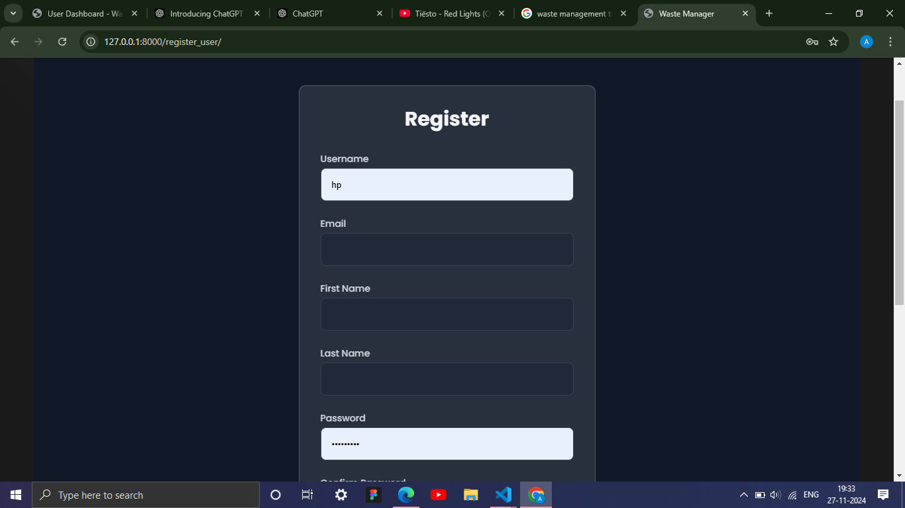
PROJECT OUTPUT

Slide 11
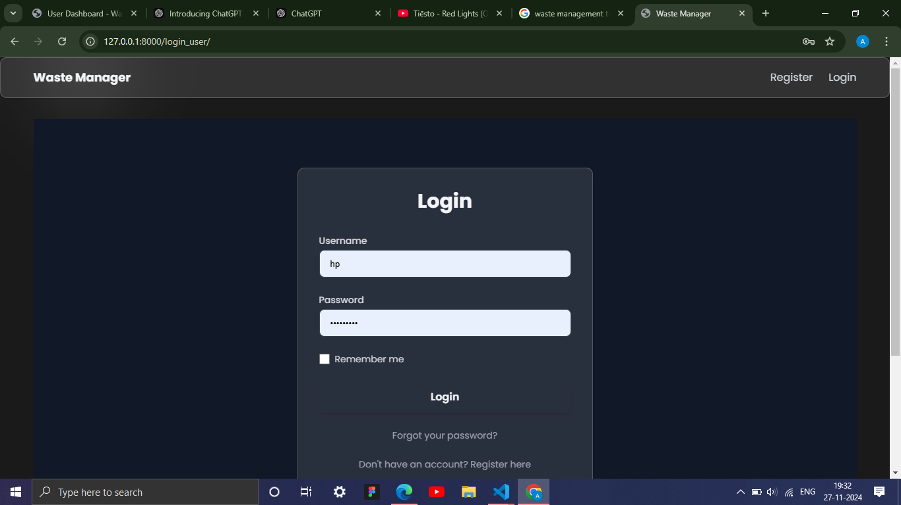
PROJECT OUTPUT

Slide 12
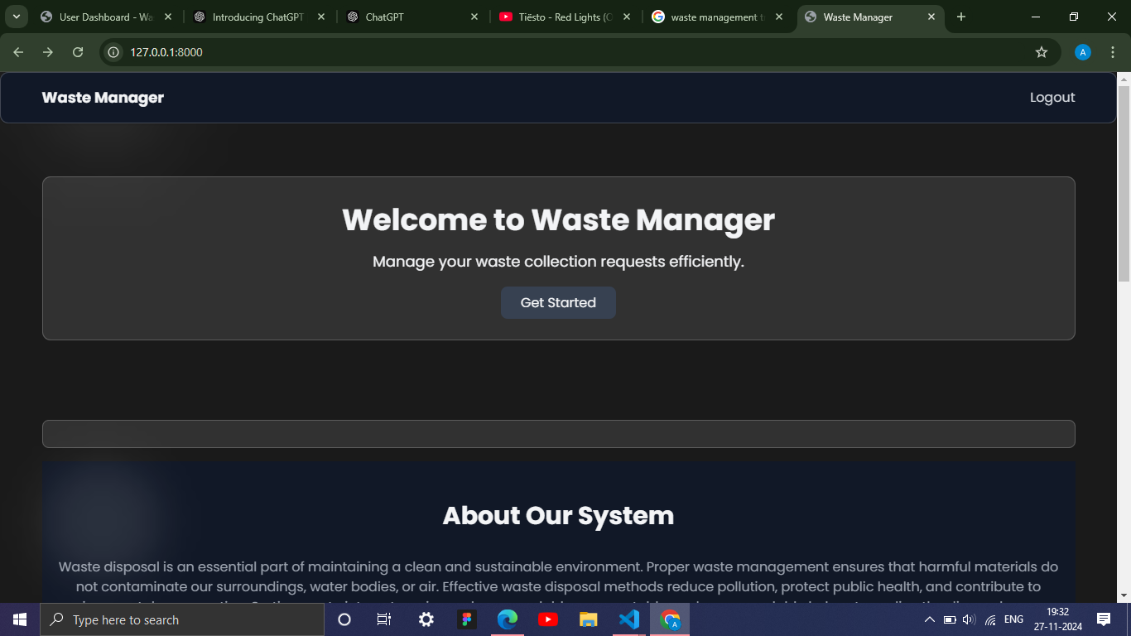
PROJECT OUTPUT

Slide 13
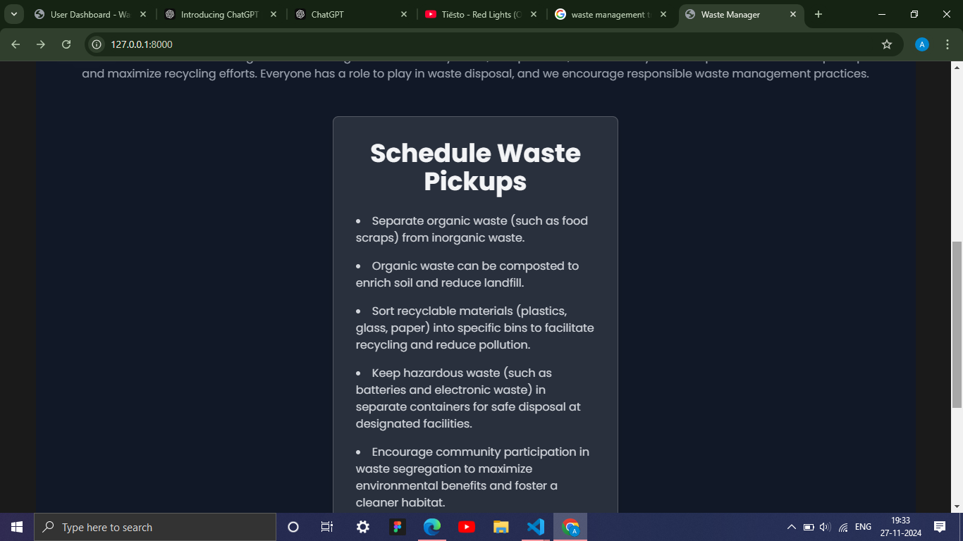
PROJECT OUTPUT

Slide 14
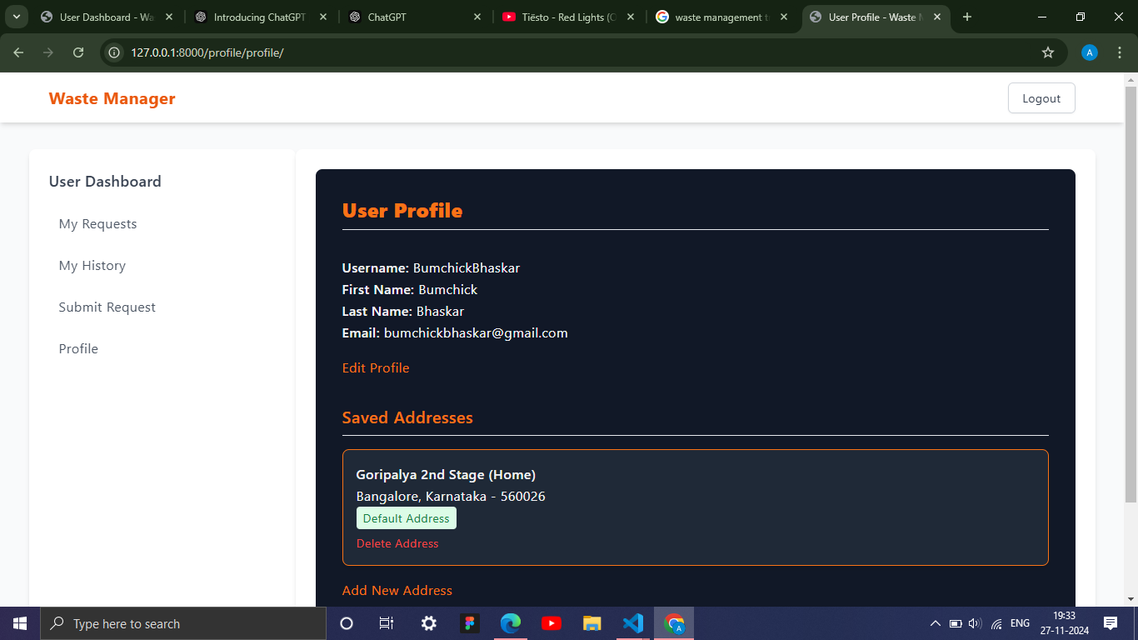
PROJECT OUTPUT

Slide 15
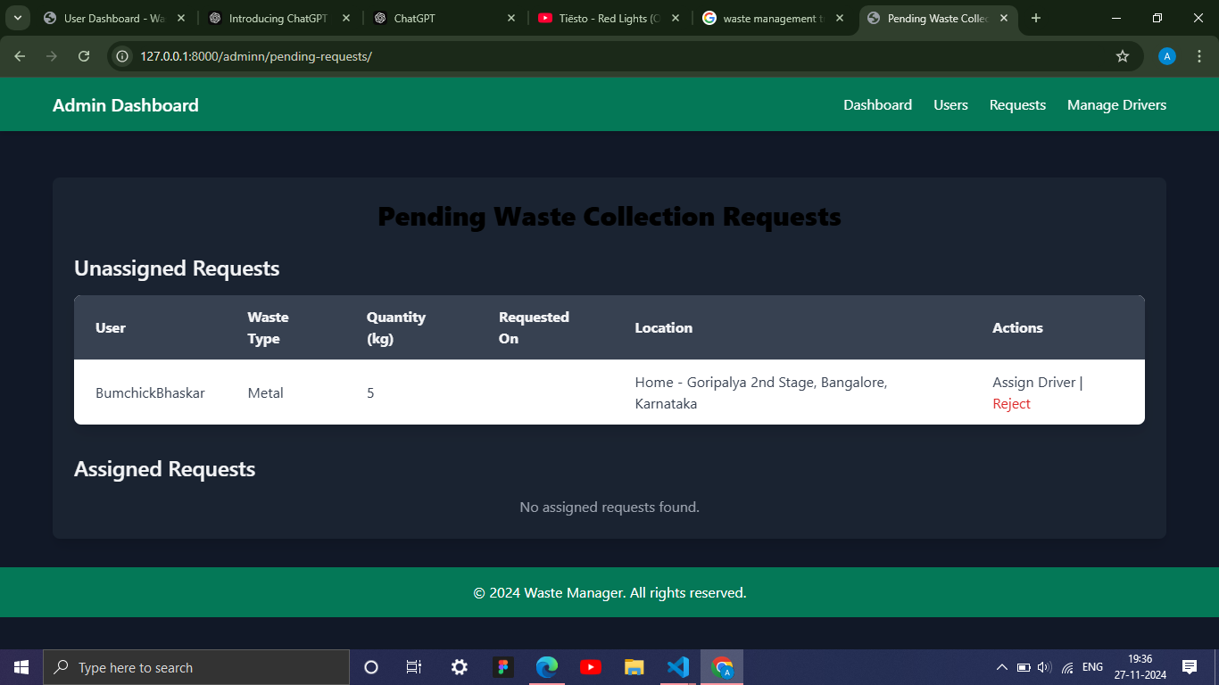
PROJECT OUTPUT

Slide 16
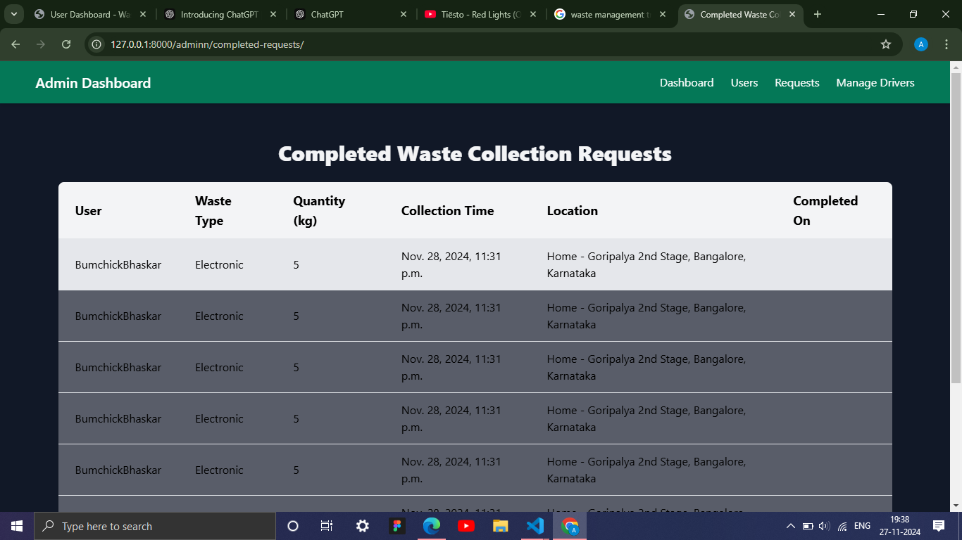
PROJECT OUTPUT

Slide 17
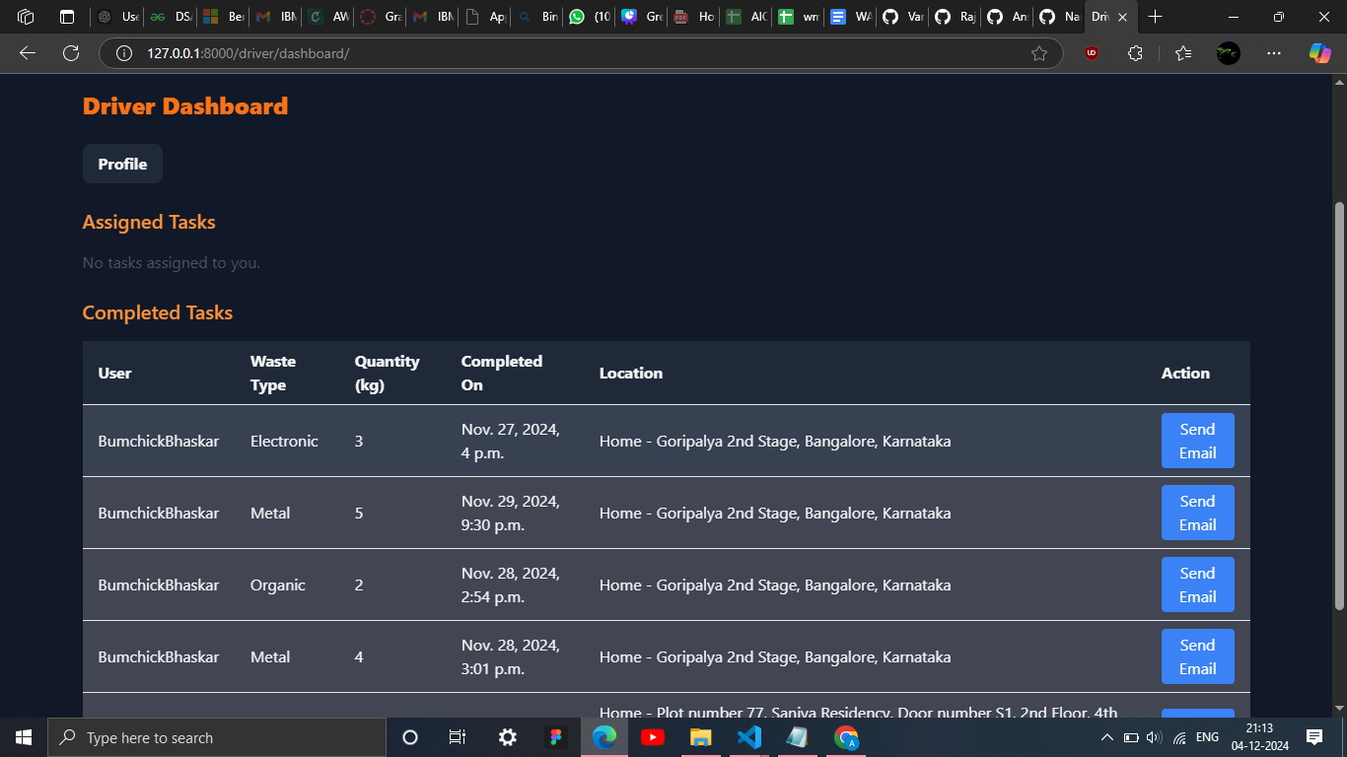
PROJECT OUTPUT

Slide 18
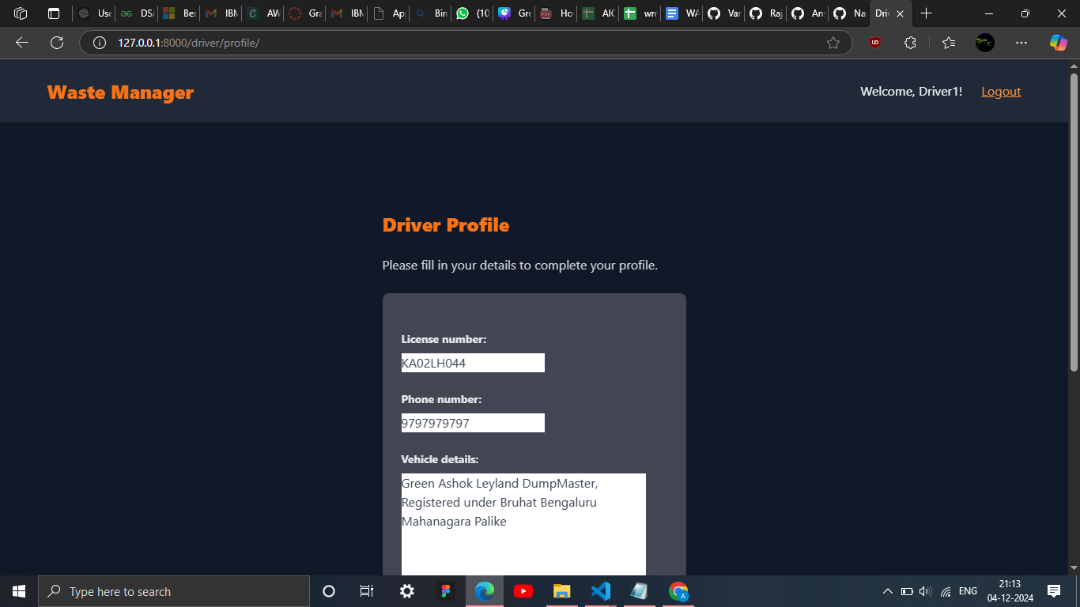
PROJECT OUTPUT

Slide 19



THANK YOU FOR YOUR ASSISTANCE

